Slide 1
AINT351: Machine Learning Lecture 6 K-means clustering

Slide 2
Clustering
Idea of clustering is to group patterns so that
Patterns are similar to one another within the same cluster
Patterns are dissimilar to those in other clusters
Several approaches exits
All require a way to determine similarity
E.g Euclidian distance
E.g Mahanalobis distance
This accounts for the fact that the variances in each direction are different
Accounts for the covariance between variables
Reduces to the familiar Euclidean distance for uncorrelated variables with unit variance

Slide 3
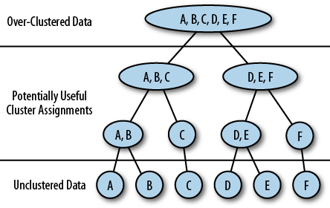
Hierarchical clustering
Breaks down the dataset into a series of nested clusters
Single cluster at top with all data
N clusters at bottom one for each data point
Can be displayed as dendrogram

Slide 4
K-means algorithm
Kmeans os a simple clustering algorithm
Implementing Kmeans is easy!
K is the number of clusters
Often K is set b y hand
Randomly assign K data points at the “centroids” of the K clusters
Loop until convergence doing the following:
For each point, put the point into the cluster to whose centroid it is closest
Recompute the cluster centroids
Repeat loop until there is no change in clusters between two consecutive iterations

Slide 5
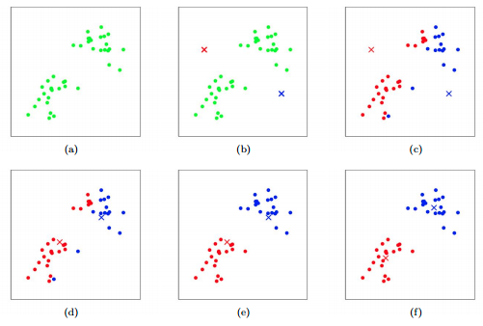
K-means operation
1: Data

Slide 6
K-means operation
2: Assign initial cluster means

Slide 7
K-means operation
3: Classify data to closest cluster mean

Slide 8
K-means operation
4: Recompute cluster means

Slide 9
K-means operation
5: Reclassify data points

Slide 10
K-means operation
6: Recompute cluster means

Slide 11
AINT351: Machine Learning Lecture 7 Mixture of Gaussians

Slide 12
Limitations of simple Gaussian and PCA models
Gaussian, FA and PCA models are easy to understand and use in practice.
They are a convenient way to reduce dimensionality of high dimensional data sets, e.g. as preprocessing
The problem is that they make very strong assumptions about the distribution of the data, only the mean and variance of the data are taken into account.
The class of densities which can be modeled is also too restrictive
By using mixtures of simple distributions, such as Gaussians, we can expand the class of densities greatly

Slide 13
Mixture models
Various types of cluster models. We already considered
Kmeans
We now consider
Mixture of Gaussians
Kmeans is an example of hard clustering
Clusters do not overlap
Data in one cluster only

Slide 14
Mixture models
Mixture of Gaussians is an example of soft clustering
Clusters may overlap
Data may exhibit non-binary strength of association to all clusters
Mixture of Gaussians
probabilistic method
Each cluster is a generative model
Clusters have parameters (means & covariance)
Train using EM

Slide 15
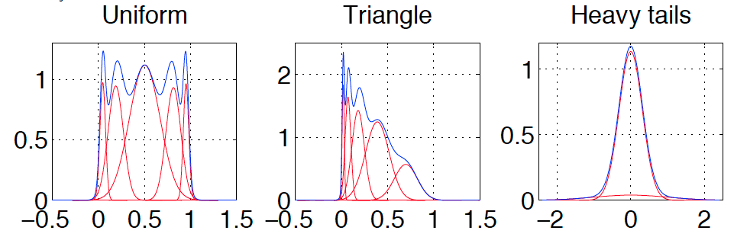
Mixture models
We can model non-Gaussian distributions using a Mixture of Gaussians
Consider the following examples
Red curves show weighted Gaussians
Blue curves show the resulting density

Slide 16
Mixture models
We can model non-Gaussian distributions using a Mixture of Gaussians
Consider the following examples
Red curves show weighted Gaussians
Blue curves show the resulting density

Slide 17
Mixture models
We can model non-Gaussian distributions using a Mixture of Gaussians
Consider the following examples
Red curves show weighted Gaussians
Blue curves show the resulting density
Advantage of MoG is that given enough components we can model most distributions using only the simple Gaussian distribution

Slide 18
Recall K-means algorithm
How is MoG implemented? Consider Kmeans again:
Randomly assign K data points at the “centroids” of the K clusters
Loop until convergence doing the following:
For each point, put the point into the cluster to whose centroid it is closest
Re-compute the cluster centroids
Repeat loop until there is no change in clusters between two consecutive iterations.
Mixture of Gaussians operates in an analogous fashion

Slide 19
EM algorithm
Need to know the Gaussian parameters (μ, σ² ) for each cluster to estimate data point cluster membership
But need to know data assignments to estimate the parameters!
Solution is to use the EM algorithm
Randomly initialize the the Gaussian cluster parameters (μ, σ² )
E step:
Look at each data point and calculate how likely it came from a given cluster:
Do so by computing p(b|x_{i})
M step:
Re-estimate Gaussian parameters (μ, σ² ) to fit the assigned points
Repeat until convergence achieved
NB: sensitive to starting point!

Slide 20
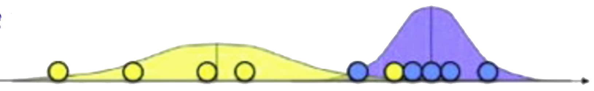
1-D mixture model case
Consider data observation x₁, x₂,.. , x_{n}
Consider case k=2
Have unknown mean μ and variance σ²
If we knew class membership parameter estimation would be trivial
For unsupervised case we do not know membership!

Slide 21
1-D mixture model case
Given parameters for both clusters μ and variance σ² we can compute probability of their data point memberships.
For a Gaussian the probability of a data point given the model is
To find the probability of the model given the data point we need to use Bayes rule

Slide 22



Bayes rule
Recall: For events A and B, provided that P(B) ≠ 0
For some partition {A_{j}} of the event space, using the law of total probability to compute P(B)

Slide 23
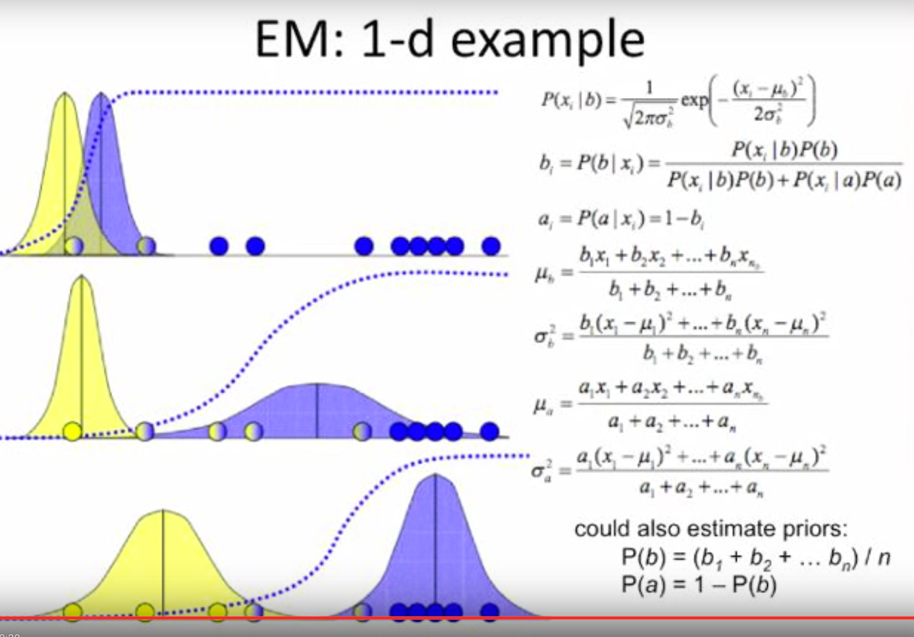
1-D mixture model case
The probability of the model b for a given the data point is given by
We can take the probability of cluster membership for each datapoint x_{i} and use it as an estimate of the responsibilities b_{i} for that datapoint
Given clusters determine which points belong to them

Slide 24
1-D mixture model case
Given cluster assignments we can re-estimate the parameters
Likewise we can do the same for
cluster a

Slide 25
1-D mixture model case
We can also estimate priors, but this is not always necessary

Slide 26
Summary: Iterative approach
Given clusters determine which points below to them

Slide 27
Summary: Iterative approach
Given clusters determine which points below to them
Given assignments update the cluster parameters

Slide 28
Summary: Iterative approach
Given clusters determine which points below to them
Given assignments update the cluster parameters
Repeat until convergence achieved

Slide 29
Multidimensional Mixture of Gaussians
Can extend MoG to multidimensional data points and any number K clusters
Again iteratively estimate parameters starting from initial guess
All sources again Gaussian but now have vector for data points and the mean, and a covariance matrix
Prior
Mean
Covariance

Slide 30
Multidimensional Mixture of Gaussians
Probability of data point (how probable is x_{i} under source c) is given by
Probability data point x_{i} came from cluster c
Importance factor w_{ic} indicating how importance is x_{i} for source c

Slide 31
Multidimensional Mixture of Gaussians
Given cluster assignments we can re-estimate the parameters
Mean of values of attribute a from c
Covariance of values a and b from c
Prior reflecting number of items assigned to c

Slide 32
Selection of number of clusters k
The MoG is a probabilistic model the finds a maximum likelihood fit to the data points
If we choose K to maximize then we will end up with a cluster per data point! This isn't normally what we want
So we cannot discover K automatically from best fit!
This model may not generalize well to future datasets
Could split data points into training and validations datasets
Occam's razor states we should choose the simplest model that explains the data
e.g. use BIC criteria – Bayes information criteria

Slide 33
Acknowledgements
Wikipedia
Victor Lavrenko
Zoubin Ghahramani

